Slide 1
Operative Services
Operating Room and Outpatient Surgical Suite

Slide 2
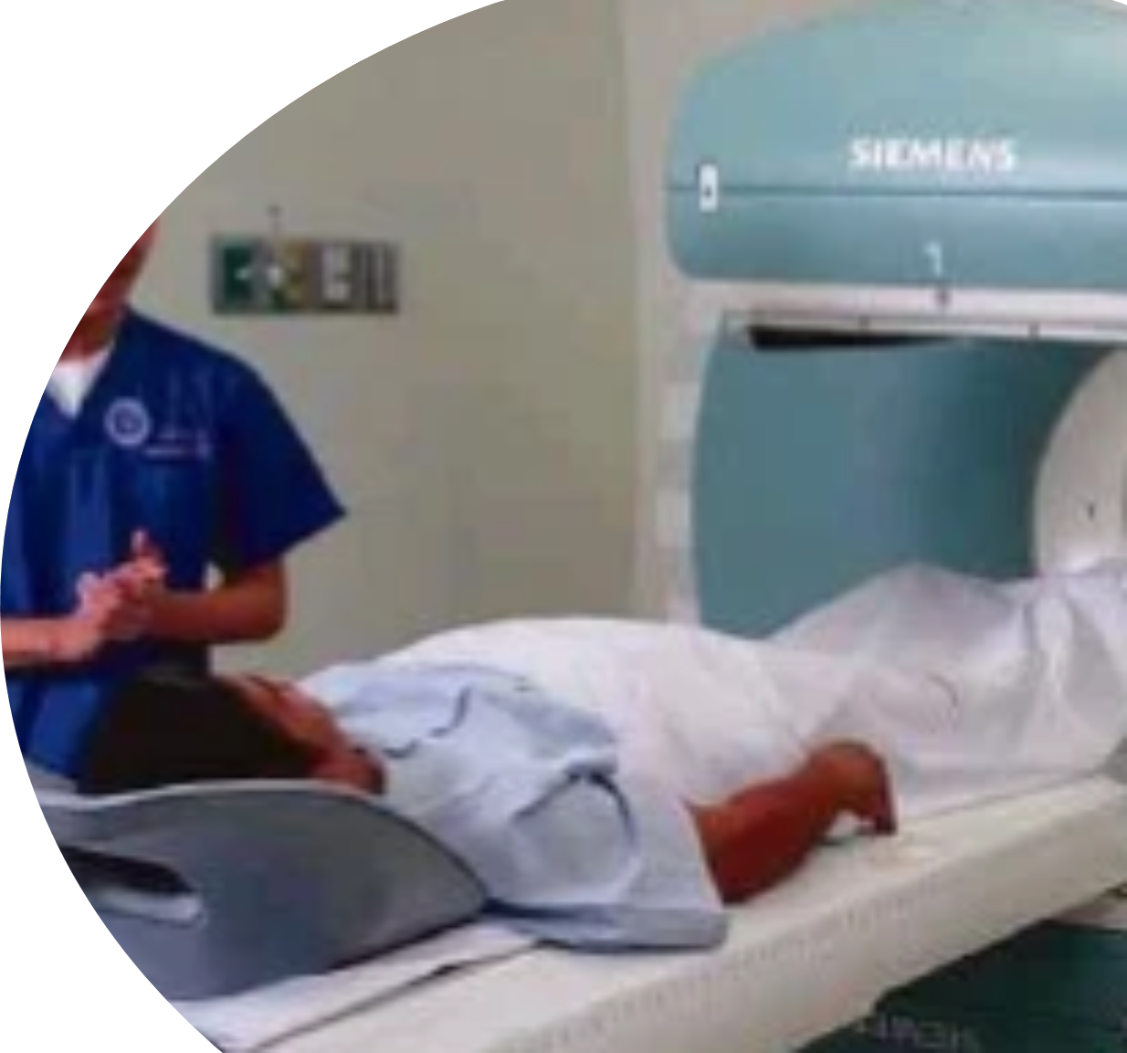
OR Revenue: May YTD vs Previous Years MoM
Summary May YTD:
1% lower than target
11% higher than last year
37% higher than 2019
Contributing Factors:
Higher revenue comparing to last year for ENT (30%), Urology (29%), Neurosurgery (61%), Additional Procedure - Robotics Surgery, Increase in Major Procedures, CABG, HPB, Neuro Surgery
*Revenue – until June 27
in Millions | Jan | Feb | Mar | Apr | May | Jun | YTD | FY
2025 Actual | 61,199 | 69,681 | 72,187 | 65,647 | 68,935 | 64,629 | 402,279
2025 Budget | 66,068 | 65,659 | 65,218 | 70,421 | 74,350 | 77,137 | 418,852 | 864,104
2024 Actual | 61,145 | 53,803 | 57,950 | 65,202 | 66,269 | 69,642 | 374,012 | 791,678
2019 Actual | 46,257 | 45,567 | 57,931 | 50,071 | 47,016 | 50,366 | 297,207 | 586,525
YoY Growth | Jan | Feb | Mar | Apr | May | Jun | YTD | Index
Act vs Bgt | (7%) | 6% | 11% | (7%) | (7%) | (16%) | (4%) | 47%
Act vs 2024 | 0% | 30% | 25% | 1% | 4% | (7%) | 8% | 51%
Act vs 2019 | 32% | 53% | 25% | 31% | 47% | 28% | 35% | 69%

Slide 3
OR Procedure Census: May YTD vs Previous Years MoM
Summary:
1% higher than target
4% higher than last year
10% lower than 2019
Contributing Factors:
Higher census for GS (18%), ENT (26%), Peripheral (12%), Colorectal (7%), Neurosurgery (8%), Pediatric (73%), HPB (24%), Ob Robotics (467%)
 | Jan | Feb | Mar | Apr | May | YTD | FY
2025 Actual | 712 | 799 | 852 | 794 | 832 | 3,989
2025 Budget | 766 | 745 | 773 | 842 | 842 | 3,968 | 9,825
2024 Actual | 743 | 727 | 746 | 817 | 815 | 3,848 | 9,409
2019 Actual | 811 | 830 | 975 | 910 | 914 | 4,440 | 10,808
YoY Growth | Jan | Feb | Mar | Apr | May | YTD | Index
Act vs Bgt | (7%) | 7% | 10% | (6%) | (1%) | 1% | 41%
Act vs 2024 | (4%) | 10% | 14% | (3%) | 2% | 4% | 42%
Act vs 2019 | (12%) | (4%) | (13%) | (13%) | (9%) | (10%) | 37%
Daily Average: 31

Slide 4
OR Patient Census: May YTD vs Previous Years MoM
Summary:
7% lower than target
3% higher than last year
12% lower than 2019
Daily Average: 30

Slide 5
EBIT : May YTD vs Previous Years MoM
Summary:
3% lower than target
11% higher than last year
21% higher than 2019
in Millions | Jan | Feb | Mar | Apr | May | YTD | FY
2025 Actual | 15,847 | 20,791 | 16,761 | 15,723 | 13,748 | 82,870
2025 Budget | 17,035 | 16,517 | 15,140 | 17,586 | 19,375 | 85,653 | 217,174
2024 Actual | 17,200 | 13,736 | 14,846 | 17,230 | 14,451 | 77,463 | 249,801
2019 Actual | 6,266 | 10,899 | 24,600 | 12,549 | 14,222 | 68,536 | 155,390
YoY Growth |  |  |  |  |  | YTD | Index
Act vs Bgt | (7%) | 26% | 11% | (11%) | (29%) | (3%) | 38%
Act vs 2024 | (8%) | 51% | 13% | (9%) | (5%) | 11% | 33%
Act vs 2019 | 153% | 91% | (32%) | 25% | (3%) | 21% | 53%

Slide 6
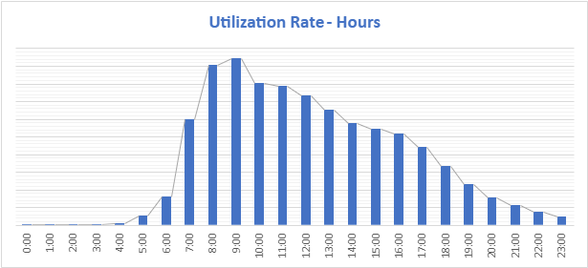
OR Room Utilization Per Hour
Notes:
Medical

Slide 7
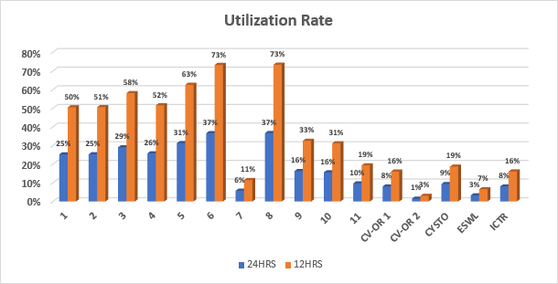
OR Utilization Per Room
Notes:
Medical

Slide 8
OR Machine Utilization: as of April
Service | Machine | Service Hours | Process Time per Output (Hours) | Max Capacity Output Per Month | Average Census per Month | Utilization Rate | NBV (as of APRIL) | Date of Purchase
GS | ICG LAP TOWER | 12 | 4 | 78 | 15 | 19% | Php9,400,000.00 | 09/21/2022
GS | BK ULTRASOUND | 12 | 10 | 31.2 | 16 | 51% | Php9,679,167.00 | 04/11/2023
GS | SPY PHI | 12 | 4 | 78 | 2 | 3% | Php7,490,000.00 | 09/14/2023
GS | GAMMA PROBE | 12 | 2 | 156 | 1 | 1% | Php2,682,500.00 | 06/19/2024
HEPATO | CUSA | 12 | 10 | 31.2 | 2 | 6% | Php8,172,666.66 | 08/22/2023
HEPATO | ROTEM | 12 | 10 | 31.2 | 0 | 0% | Php5,500,000.00 | 01/26/2024
HEPATO | HEMOSPHERE | 12 | 10 | 31.2 | 3 | 10% | Php7,266,666.00 | 04/25/2024
ORTHO | TRIOS SPINE TABLE | 12 | 5 | 62.4 | 3 | 5% | Php11,120,000.00 | 02/20/2023
ORTHO | TRIMANO ARM POSITIONER | 12 | 3 | 104 | 1.5 | 1% | Php1,891,500.00 | 10/23/2024
NEURO | KICK NAVIGATION | 12 | 4 | 78 | 3 | 4% | Php4,684,401.00 | 10/14/2017
NEURO | SONOCA | 12 | 6 | 52 | 1 | 2% | Php876,274.80 | 12/23/2016
NEURO | TIVATO MICROSCOPE | 12 | 6 | 52 | 6 | 12% | Php9,273,333.00 | 05/29/2023
URO | ESWL | 12 | 1 | 312 | 3 | 1% | Php15,450,000.00 | 08/23/2023
URO | DA VINCI ROBOT | 12 | 4 | 78 | 6 | 7% | Php144,664,683.00 | 02/14/2024
URO | MRI KOELIS | 12 | 1 | 312 | 7 | 2% | Php15,866,666.00 | 05/20/2024
URO | THULIUM LASER | 12 | 1 | 312 | 5 | 2% | Php8,983,333.00 | 06/06/2024
TCVS | BELMONT RAPID INFUSER | 12 | 8 | 39 | 2 | 4% | Php3,997,500.00 | 11/05/2024
PULMO | BRONCHOSCOPE SYSTEM | 12 | 1 | 312 | 6 | 2% | Php4,224,741.00 | 01/07/2019
ENT | CURIS RF MACHINE | 12 | 1 | 312 | 1 | 0% | Php1,691,667.00 | 10/11/2024
Notes:
Medical

Slide 9
OR Top Procedure May YTD : IP and OP
INPATIENT
OUTPATIENT
 | Procedure | 2025 | 2024 | Variance
1 | LAPAROSCOPIC CHOLECYSTECTOMY | 272 | 236 | 15%
2 | WOUND DEBRIDEMENT | 133 | 166 | (20%)
3 | THYROIDECTOMY | 104 | 102 | 2%
4 | LAPAROSCOPIC APPENDECTOMY | 96 | 71 | 35%
5 | MODIFIED RADICAL MASTECTOMY | 74 | 55 | 35%
6 | EXPLORATORY LAPAROTOMY | 46 | 42 | 10%
7 | EXCISION OF CYST/MASS | 29 | 18 | 61%
8 | OPEN CHOLECYSTECTOMY | 28 | 34 | (18%)
9 | APPENDECTOMY | 27 | 51 | (47%)
10 | INCISION AND DRAINAGE | 25 | 36 | (31%)
 | Procedure | 2025 | 2024 | Variance
1 | PHACOEMULSIFICATION WITH IOL | 520 | 541 | (4%)
2 | EXCISION OF CYST/MASS | 150 | 182 | (18%)
3 | INTRAVITREAL INJECTION | 89 | 91 | (2%)
4 | INCISION AND CURETTAGE CHALAZION | 72 | 97 | (26%)
5 | VITRECTOMY | 49 | 32 | 53%
6 | EPIDURAL STEROID INJECTION | 49 | 32 | 53%
7 | WOUND DEBRIDEMENT | 41 | 81 | (49%)
8 | ESWL | 34 | 72 | (53%)
9 | PROSTATE BIOSPY | 32 | 29 | 10%
10 | EXCISION OF BREAST MASS | 29 | 28 | 4%

Slide 10
OR Census Per Specialty: May YTD
SECTIONS | 2025 | % to Total | 2024 | Variance
 |  |  |  | vs 2024
General Surgery | 1,228 | 31% | 1,040 | 18%
Ophthalmology | 875 | 22% | 877 | (0.2%)
Orthopaedic | 673 | 17% | 705 | (5%)
Otorhinolary | 275 | 7% | 218 | 26%
Urology | 264 | 7% | 279 | (5%)
Peripheral Vascular | 225 | 6% | 201 | 12%
Colorectal Surgery | 89 | 2% | 83 | 7%
Neurosurgery | 86 | 2% | 80 | 8%
Pediatric Surgery | 83 | 2% | 48 | 73%
Thoracic Cardiovascular | 72 | 2% | 97 | (26%)
Plastic Surgery | 37 | 1% | 45 | (18%)
Hepatobiliary | 42 | 1% | 34 | 24%
Obstetrics | 17 | 0.4% | 3 | 467%
Dermatology | 15 | 0.4% | 28 | (46%)
Gastroenterology | 8 | 0.2% | 12 | (33%)
GRAND TOTAL | 3,989 | 100% | 3,750 | 6.4%
Notes:
Lower phaco census (Cataract and Incision and Curettage), Ophtha Doctors on leave:
Dr. Paulino - May 18 -25
Dr. D. Cruz - May 1-12
Dr. M. Meriales - May 6-23
Lower ESWL census by 38%. Doctors on Leave:
Dr. Songco - Apr 16 - May 6
Dr. Saulog - May 10 - 26

Slide 11
OR Revenue Per Specialty: May YTD
SECTIONS | 2025 | % to Total | 2024 | 2019 | Variance
 |  |  |  |  | vs 2024 | vs 2019
General Surgery | 94,160 | 27% | 88,518 | 75,026 | 6% | 26%
Orthopaedic Surgery | 63,487 | 19% | 69,111 | 57,229 | (8%) | 11%
Ophthalmology | 29,620 | 9% | 28,256 | 18,865 | 5% | 57%
Otorhinolaryngology | 25,263 | 7% | 18,658 | 19,769 | 35% | 28%
Urology | 25,589 | 7% | 22,119 | 12,778 | 16% | 100%
Thoracic Cardiovascular Surgery | 21,524 | 6% | 21,105 | 25,307 | 2% | (15%)
Neurosurgery | 20,183 | 6% | 14,166 | 16,077 | 42% | 26%
Peripheral Vascular Surgery | 17,112 | 5% | 15,553 | 13,003 | 10% | 32%
Hepatobiliary Surgery | 15,752 | 5% | 10,977 | 1,079 | 44% | 1360%
Obstetrics and Gynecology | 9,388 | 3% | 1,717.38 | 90.732 | 447% | 10247%
Colorectal Surgery | 10,070 | 3% | 10,323 | 1,759 | (2%) | 473%
Pediatric Surgery | 4,947 | 1% | 2,724 | 2,591 | 82% | 91%
Plastic Surgery | 2,547 | 1% | 2,533 | 2,635 | 1% | (3%)
Other Services | 3,434 | 2% | 4,789 | 2,448 | (28%) | 40%
GRAND TOTAL | 343,076 | 100% | 308,015 | 248,655 | 11% | 38%

Slide 12
OR Top Procedure Per Service: May YTD vs 2024
GENERAL SURGERY
 | GENERAL SURGERY | 2025 | 2024 | Variance
1 | LAPAROSCOPIC CHOLECYSTECTOMY | 265 | 225 | 18%
2 | EXCISION OF CYST/MASS | 114 | 133 | (14%)
3 | MODIFIED RADICAL MASTECTOMY | 91 | 72 | 26%
4 | LAPAROSCOPIC APPENDECTOMY | 80 | 67 | 19%
5 | WOUND DEBRIDEMENT | 46 | 71 | (35%)
 | HEPATOBILIARY | 2025 | 2024 | Variance
1 | LAPAROSCOPIC CHOLECYSTECTOMY | 6 | 10 | (40%)
2 | LAPAROSCOPIC HEPATECTOMY | 5 | 10 | (50%)
3 | OPEN CHOLECYSTECTOMY | 4 | 1 | 300%
4 | LAPAROSCOPIC APPENDECTOMY | 3 | 0 | -
5 | DIAGNOSTIC LAPAROSCOPY | 3 | 4 | (25%)
 | COLORECTAL | 2025 | 2024 | Variance
1 | FISTULECTOMY/FISTULOTOMY | 16 | 14 | 14%
2 | EXPLORATORY LAPAROTOMY | 14 | 13 | 8%
3 | HEMORRHOIDECTOMY | 10 | 8 | 25%
4 | LAPAROSCOPIC COLON SURGERY | 7 | 6 | 17%
5 | TAKE DOWN COLOSTOMY | 5 | 1 | 400%
 | PLASTIC SURGERY | 2025 | 2024 | Variance
1 | WOUND DEBRIDEMENT | 5 | 19 | (74%)
2 | CHANGE OF DRESSING, REMOVAL OF SKIN STAPLES/SUTURES | 2 | 0 | -
3 | EXCISION BIOPSY LYMPH NODE | 2 | 4 | (50%)
4 | REM. OF IMPLANT | 2 | 0 | -
5 | ABDOMINOPLASTY | 2 | 0 | -

Slide 13
OR Top Procedure Per Service: May YTD vs 2024
 | UROLOGY | 2025 | 2024 | Variance
1 | ESWL | 45 | 82 | (45%)
2 | PROSTATE BIOSPY | 38 | 33 | 15%
3 | CYSTOSCOPY, REMOVAL OF DJ STENT | 25 | 14 | 79%
4 | CYSTOSCOPY | 23 | 22 | 5%
5 | CYSTOSCOPY, DJ STENTING | 12 | 6 | 100%
 | OPHTHALMOLOGY | 2025 | 2024 | Variance
1 | PHACOEMULSIFICATION WITH IOL | 528 | 548 | (4%)
2 | INTRAVITREAL INJECTION | 90 | 91 | (1%)
3 | INCISION AND CURETTAGE CHALAZION | 72 | 97 | (26%)
4 | VITRECTOMY | 55 | 41 | 34%
5 | EXCISION OF PTERYGIUM | 21 | 17 | 24%
 | NEUROSURGERY | 2025 | 2024 | Variance
1 | CRANIOTOMY EXCISION OF TUMOR | 15 | 8 | 88%
2 | LAMINECTOMY | 7 | 3 | 133%
3 | VENTRICULOSTOMY | 5 | 3 | 67%
4 | VENTRICULO PERITONEAL SHUNTING | 5 | 5 | 0%
5 | DECOMPRESSIVE HEMICRANIECTOMY | 5 | 0 | -
 | TCVS | 2025 | 2024 | Variance
1 | CORONARY ARTERY BYPASS GRAFT | 20 | 10 | 100%
2 | BRONCHOSCOPY, FLEXIBLE | 9 | 7 | 29%
3 | BRONCHOSCOPY | 8 | 17 | (53%)
4 | VATS | 7 | 0 | -
5 | THORACOTOMY | 3 | 0 | -

Slide 14
OR Top Procedure Per Service: May YTD vs 2024
 | ORTHOPEDICS | 2025 | 2024 | Variance
1 | WOUND DEBRIDEMENT | 82 | 120 | (32%)
2 | EPIDURAL STEROID INJECTION | 55 | 36 | 53%
3 | ARTHROSCOPIC, KNEE | 41 | 43 | (5%)
4 | ARTHROSCOPIC ANTERIOR CRUCIATE LIGAMENT RECONSTRUCTION, KNEE | 30 | 42 | (29%)
5 | EXCISION OF CYST/MASS | 25 | 22 | 14%
 | OTORHINOLARYNGOLOGY | 2025 | 2024 | Variance
1 | THYROIDECTOMY | 70 | 62 | 13%
2 | EXCISION OF CYST/MASS | 31 | 26 | 19%
3 | TYMPANOPLASTY | 24 | 5 | 380%
4 | TONSILLECTOMY | 21 | 16 | 31%
5 | FUNCTIONAL ENDOSCOPIC SINUS SURGERY | 14 | 11 | 27%
 | PEDIATRIC SURGERY | 2025 | 2024 | Variance
1 | WOUND DEBRIDEMENT | 20 | 8 | 150%
2 | LAPAROSCOPIC APPENDECTOMY | 11 | 4 | 175%
3 | CIRCUMCISION | 9 | 7 | 29%
4 | HERNIOTOMY | 9 | 7 | 29%
5 | EXPLORATORY LAPAROTOMY | 6 | 6 | 0%
 | PERIPHERAL SURGERY | 2025 | 2024 | Variance
1 | CREATION OF ARTERIO-VENOUS FISTULA | 38 | 30 | 27%
2 | PERM CATHETER INSERTION | 25 | 5 | 400%
3 | PORTA CATHETER IMPLANTATION | 20 | 20 | 0%
4 | WOUND DEBRIDEMENT | 16 | 20 | (20%)
5 | CREATION OF ARTERIO-VENOUS GRAFT, | 15 | 19 | (21%)

Slide 15
Outpatient Surgical Suite: May YTD vs 2024
Daily Average : 6
Summary:
1% higher than target
48% higher than last year
201% higher than last year
Summary:
1% lower than target
41% higher than last year
95% higher than last year

Slide 16
Robotic Assisted Surgery Census: as of June 13
Service | 2024 | 2025 | Total
Gynecology | 25 | 17 | 42
Urology | 16 | 12 | 28
Hepatobiliary | 9 | 7 | 16
Colorectal | 4 | 2 | 6
Gyne/Urology | 1 | 1 | 2
ENT | 1 | 1 | 2
Colorectal/Gyne | 1 |  | 1
Colorectal/Hepatobiliary | 1 |  | 1
Gyne/Colorectal | 1 |  | 1
Grand Total | 59 | 40 | 99
Surgeon | 2024 | 2025 | Total
Jennifer Marie Jose | 16 | 12 | 28
Catherine Teh | 9 | 7 | 16
Jaime Songco | 9 | 7 | 16
Rebecca Singson | 8 | 2 | 10
Stephen Nazareth | 4 | 4 | 8
Mark Augustine Onglao | 4 | 2 | 6
Renee Vina Sicam |  | 2 | 2
Rebecca Singson/Mark Onglao | 1 |  | 1
Mark Augustine Onglao/Jennifer Marie Jose | 1 |  | 1
Erwin Kanapi/Arsenio Cabungcal/Ana Ignacio | 1 |  | 1
Hermenegildo Jose Zialcita | 1 |  | 1
Jaime Songco/Hermenegildo Zialcita |  | 1 | 1
Mark Augustine Onglao/Catherine Teh | 1 |  | 1
Glen Santok | 1 |  | 1
Jose Vicente Prodigalidad | 1 |  | 1
Romelyn Imperio-Onglao/Ana Cabungcal |  | 1 | 1
Mari Cruz-Javier |  | 1 | 1
Jennifer Marie Jose/Rebecca Singson | 1 |  | 1
Arsenio Cabungcal |  | 1 | 1
Jennifer Marie Jose/Stephen Nazareth | 1 |  | 1
Grand Total | 59 | 40 | 99
Average/ Month
2024: 7
2025: 7
Notes:
Medical leave of Surgeons- OB
Vacation Leave; Dr. Songco

Slide 17
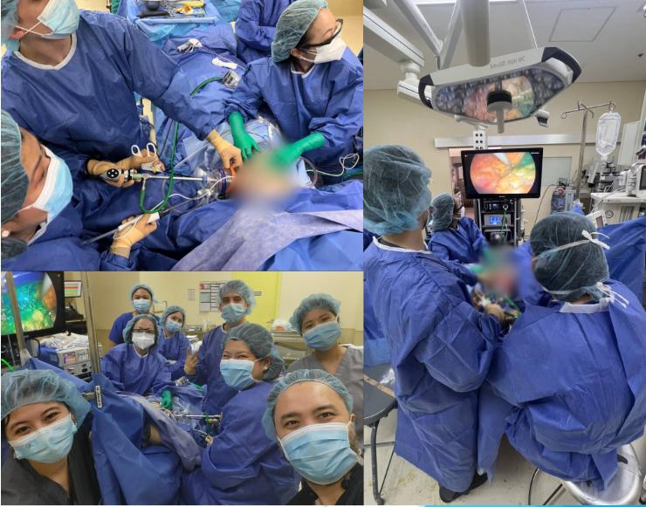
1st Minimally Invasive Breast Surgery
Notes:
Medical

Slide 18
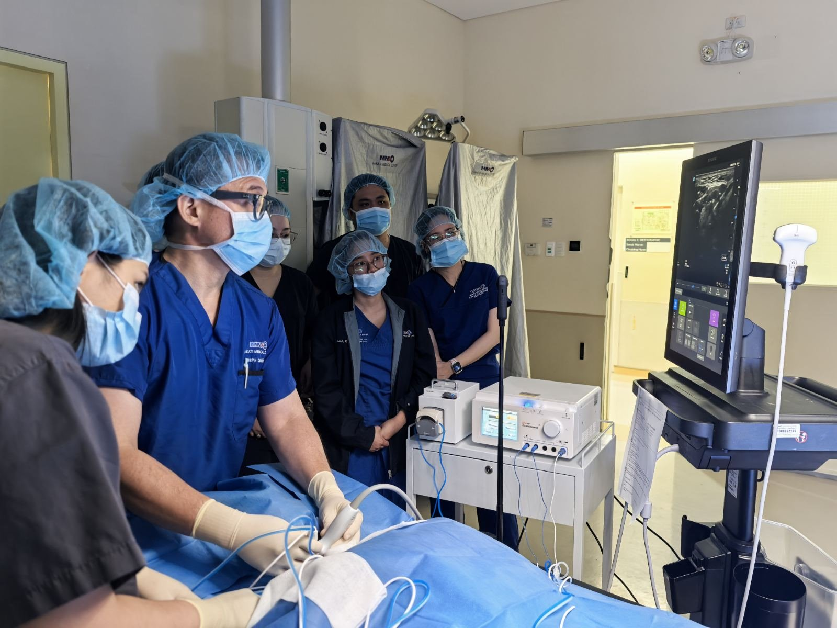
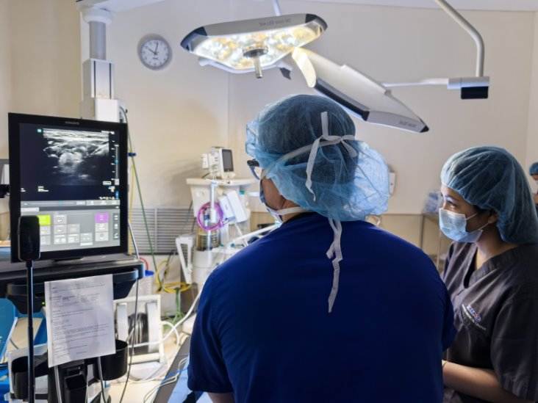
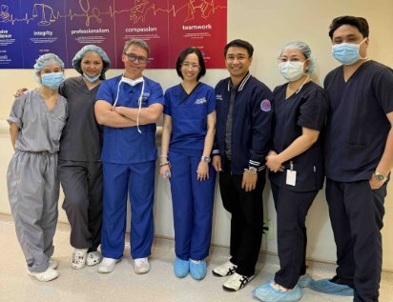
1st Radiofrequency Thyroid in MMC
Dr. Joseph Ray Richard Cedeño
May 23, 2025
Notes:
Medical

Slide 19
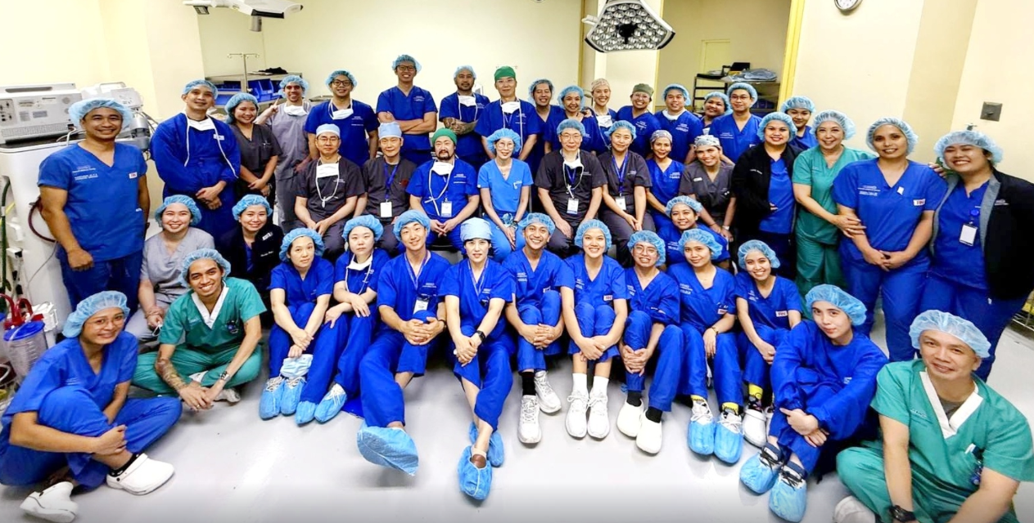
Liver Transplant: 1st Procedure June 18, 2025
LT Surgical Team
Notes:
Medical

Slide 20
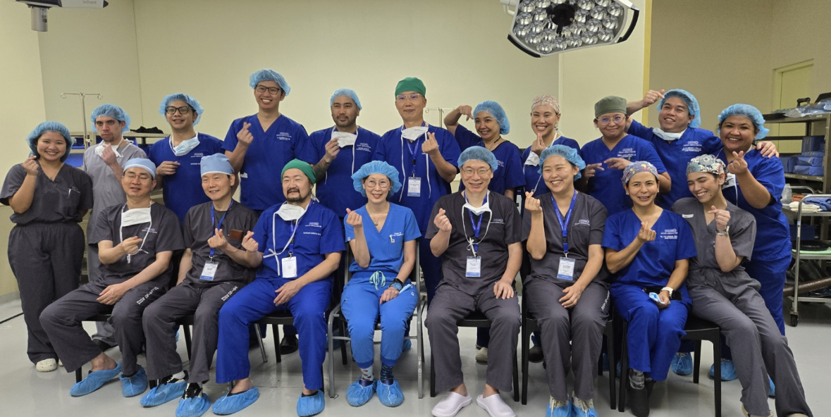
Liver Transplant: 1st Procedure June 18, 2025
LT Surgical Team
Doctors
Notes:
Medical

Slide 21
Thank You

